Slide 1
Ancient History Kick-start to GCSE
Before you begin: find a family member or a friend (or a pet!) and explain to them why you have chosen to study ancient History gcse.

Slide 2
What do I need to do?
Complete the following tasks on paper or using your iPad. Be creative with this work and take pride in it – it’s the first work you will complete for your GCSE in Ancient History!
Bring your work to your first Ancient History lesson.

Slide 3
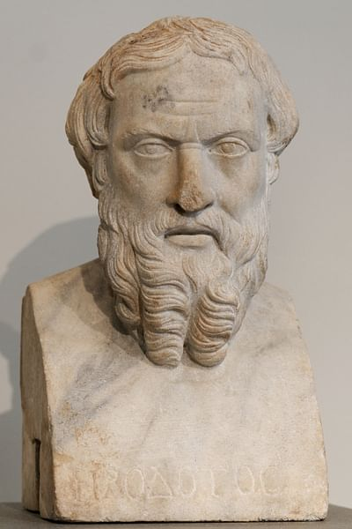
Task 1: Herodotus
Practice saying Herodotus (Her-od-o-tus).
Herodotus is one of the most important ancient historical authors. He is often known as ‘The father of history and the father of lies.’
What impression does this unusual title give you of Herodotus and his book, Histories?
Can you find out why he has this title?

Slide 4
Task 1: Herodotus
Read the introduction to Herodotus’ book, Histories.
What can you learn about why Herodotus wrote this book?
This is the display of the inquiry of Herodotus of Halicarnassus, so that things done by man not be forgotten in time, and that great and marvellous deeds, some displayed by the Hellenes, some by the barbarians, not lose their glory, including among others what was the cause of their waging war on each other.
Herodotus, Histories, Book 1

Slide 5
Task 1: Herodotus
Read the short biography of Herodotus from Brown University
What can you learn about Herodotus from this biography?
What aspects of Herodotus’ life are we unsure about?
What problems are there with reading Herodotus’ book?

Slide 6
Task 2: Key terminology
Ancient History has some unusual names that you will get used to very quickly. To help you settle in, find out who the following people were and write a sentence or two about each one. Practice saying their names, too!
Cyrus the Great (SIGH-rus)
Astyages (Ast-ee-ay-gees)
Cambyses II (Cam-BYE-sees)
Darius I (Da-RYE-us or Dah-ree-us – both are used!)
Xerxes I (Zerc-sees)
Ahura Mazda (sometimes spelled Ahuramazda – a god, not a person)

Slide 7
Task 3: Building an Empire
You are an ancient monarch, ruling a small kingdom. You are popular with your people, but there are those in your inner circle who want to replace you.
You decide to demonstrate your power by building an empire. Use the questions below to create a plan how you will do it.
What is an empire?
What will you need to build your empire? Think about resources and people.
Look at the map on the next page. Where will you take over first? Why? Where will you take over next? How will you defeat your enemies? Annotate the map to show the extent of your new empire.
Oh no! One of the kingdoms you’ve taken over rebels against you! How will you quash the rebellion? Will you be merciful to its leaders, or will you punish them severely?
Now your empire is under control, how will you keep control of it for years to come?

Slide 8
