Slide 1
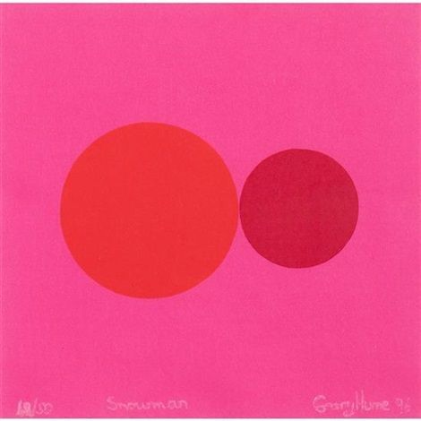
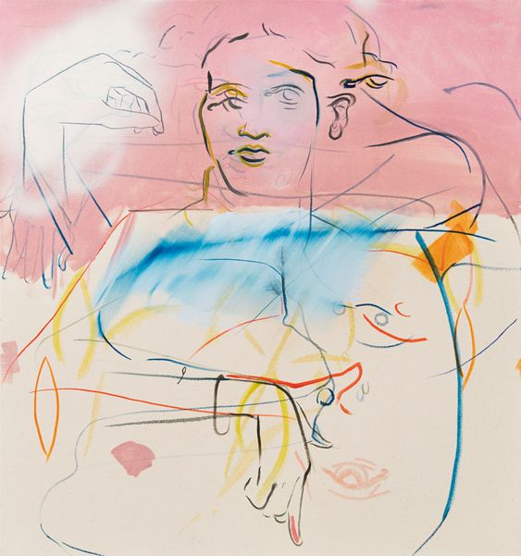
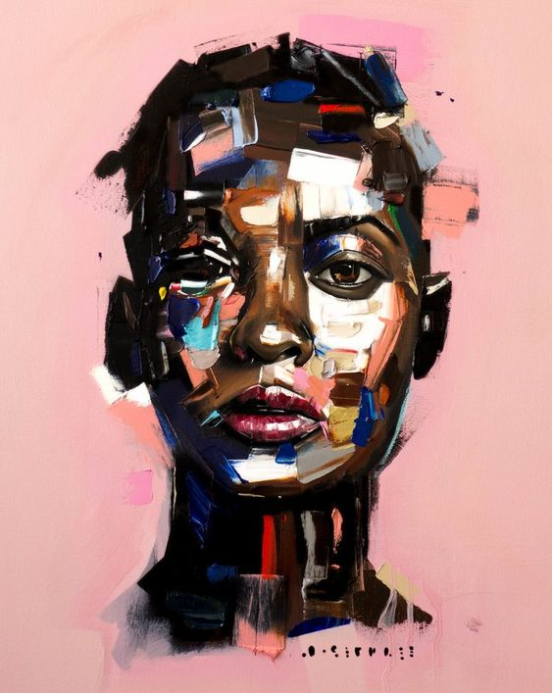
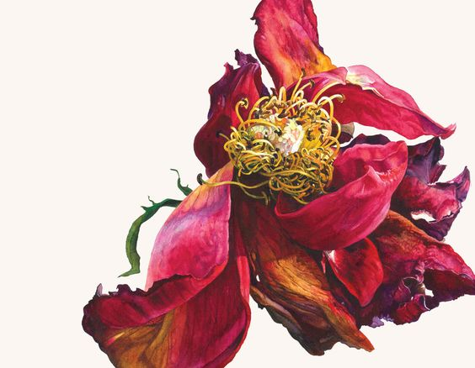
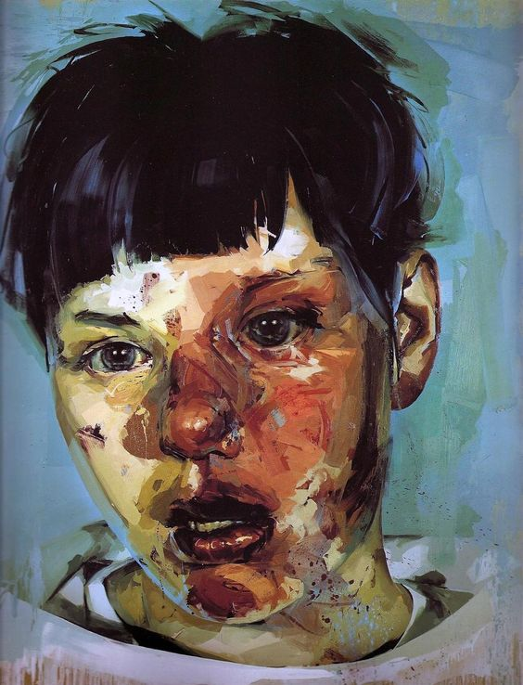
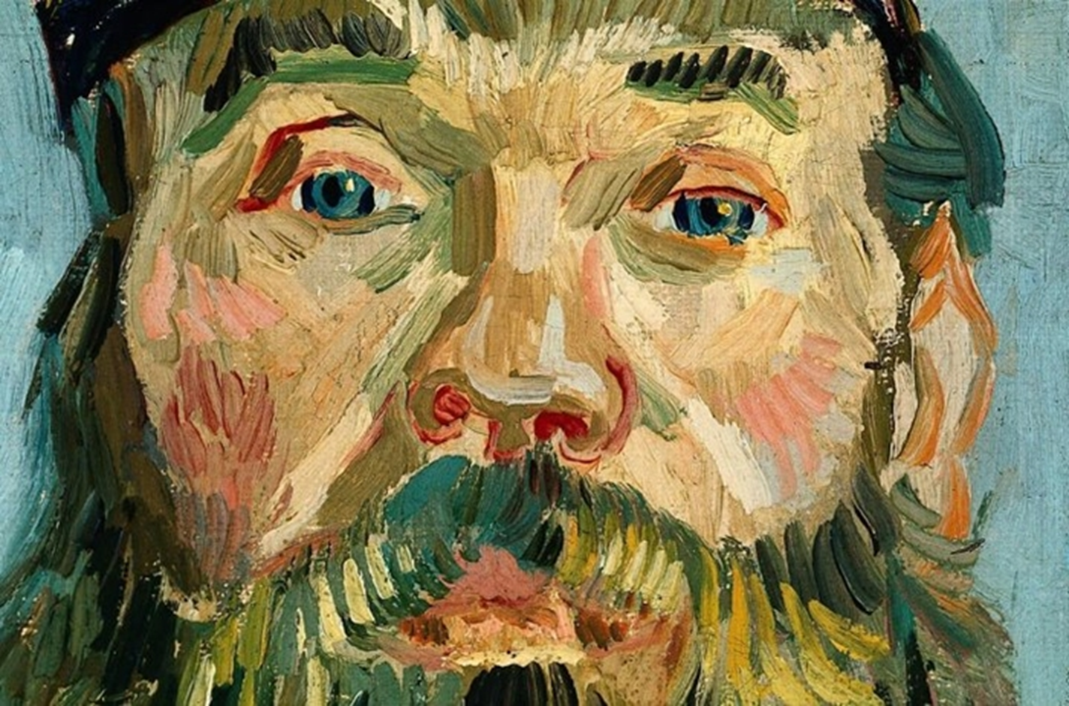
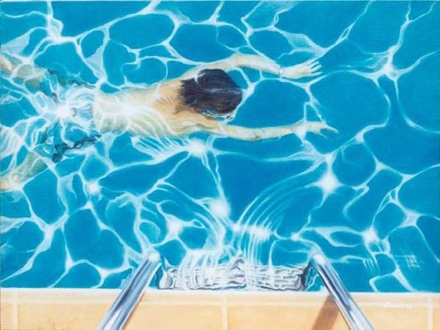
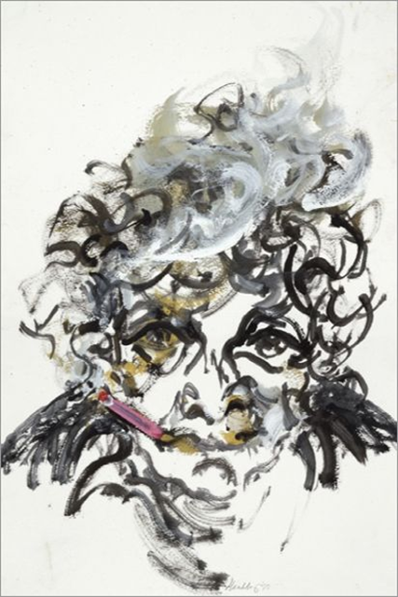
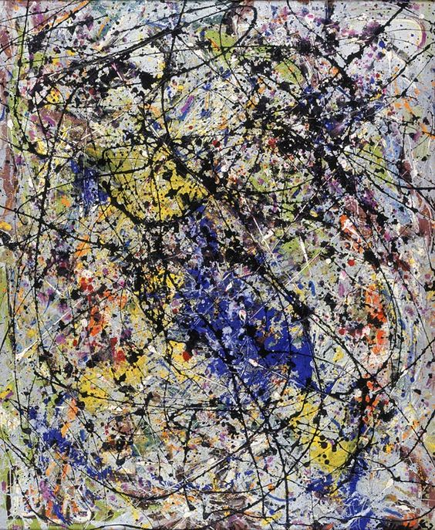
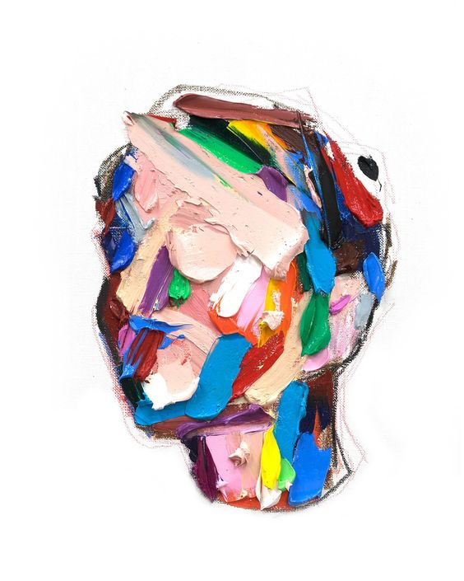
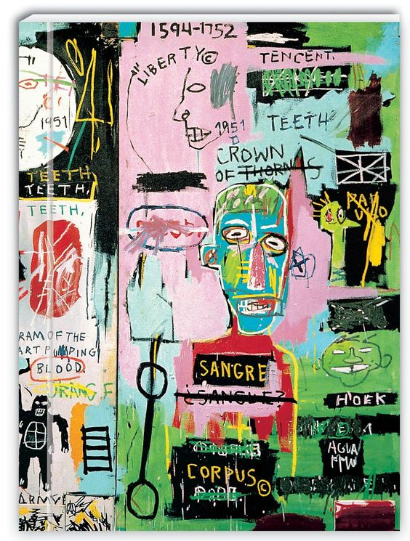
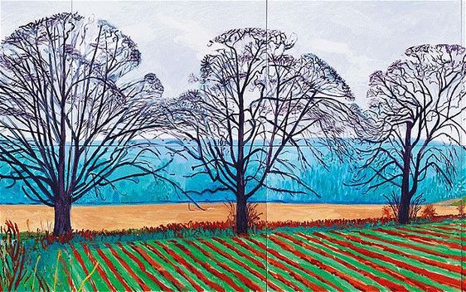
We hope you were inspired by the GCSE and A Level Art Exhibition viewing and have taken lots of ideas for the summer prep task.
Please see details of the summer prep task on the following slides. These tasks need to be completed ready for your first GCSE Art lesson back after the summer holidays.
We look forward to seeing you in September.

Slide 2
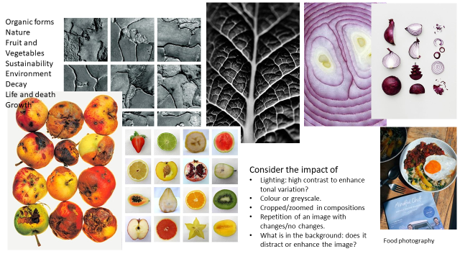
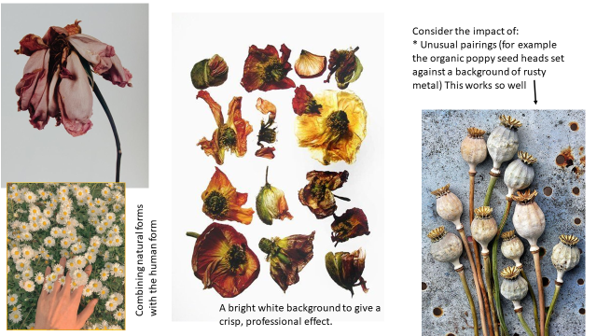
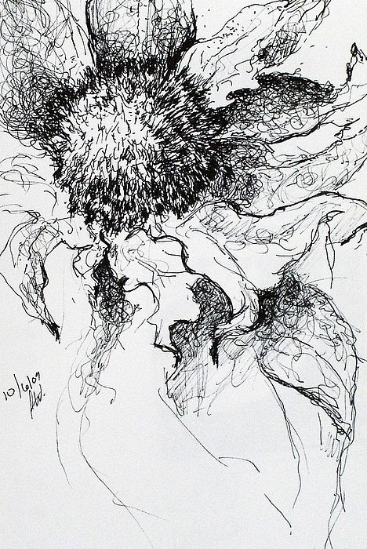
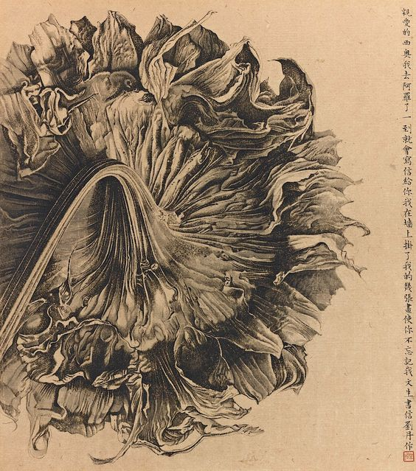
Set: 26.06.24
Due in: Week beginning 02.09.24
You summer ‘prep’ task is:
Take and send by e-mail a collection of your own photographs on the theme of Organic/Natural Forms (at least 10)
Complete a sustained, tonal drawing from one of your photographs.
Any problems with printing please e-mail your photographs to one of us from your school e-mail address BEFORE the due date: kandrews@dma.tela.org.uk or rnicholson@dma.tela.org.uk
Good luck – we can not wait to see your outcomes.
You DO NOT need an expensive camera, you can take amazing photographs on your phone or I pad.
Complete the sustained drawing in your homework sketchbook.

Slide 3
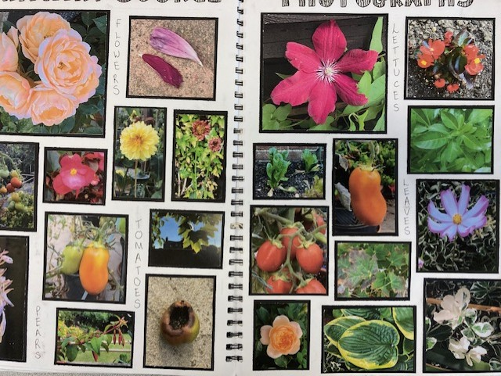
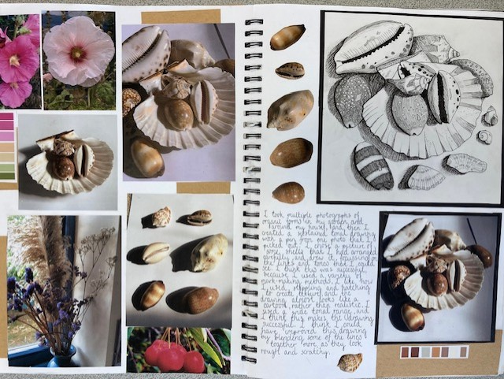
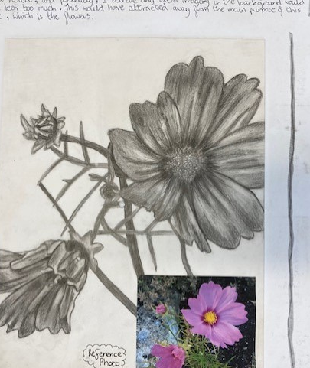
Organic/Natural Form photographs Sustained drawing from a chosen photograph
Please complete your sustained drawing in your A4 ‘Prep’/homework booklet. You can use pencil or biro.

Slide 4
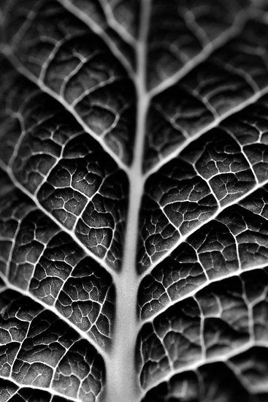
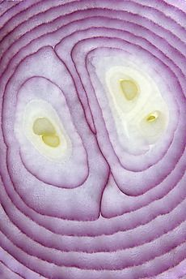
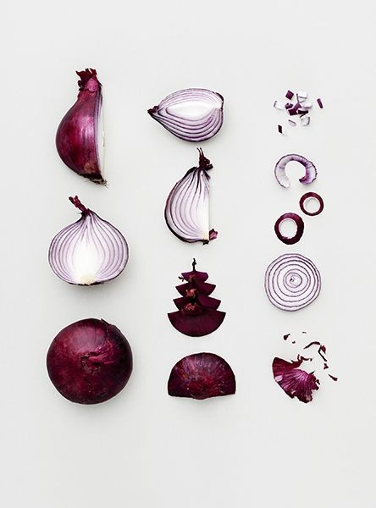
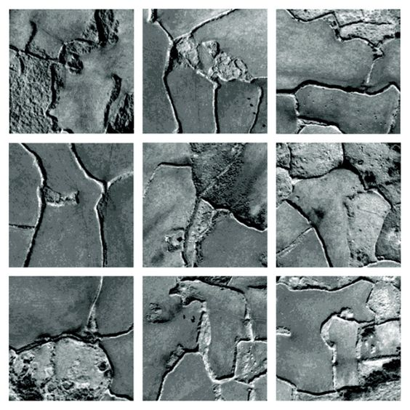
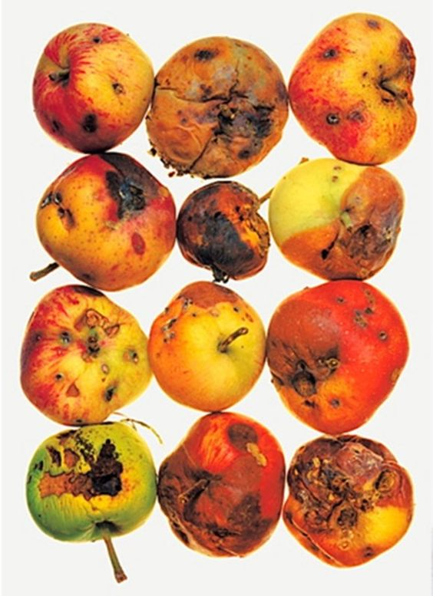
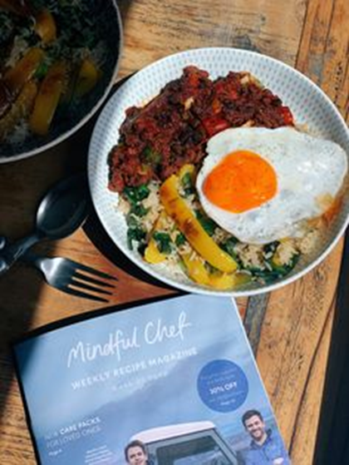
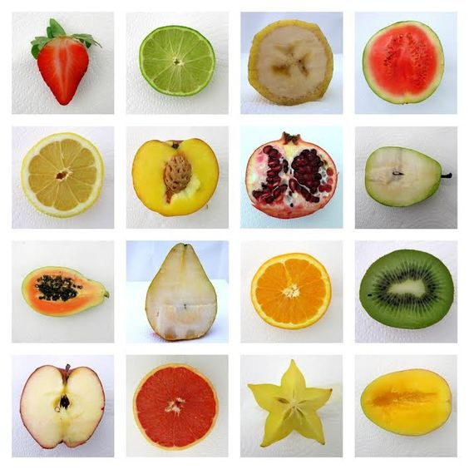
Organic forms
Nature
Fruit and Vegetables
Sustainability
Environment
Decay
Life and death
Growth
Consider the impact of
Lighting: high contrast to enhance tonal variation?
Colour or greyscale.
Cropped/zoomed in compositions
Repetition of an image with changes/no changes.
What is in the background: does it distract or enhance the image?
Food photography

Slide 5
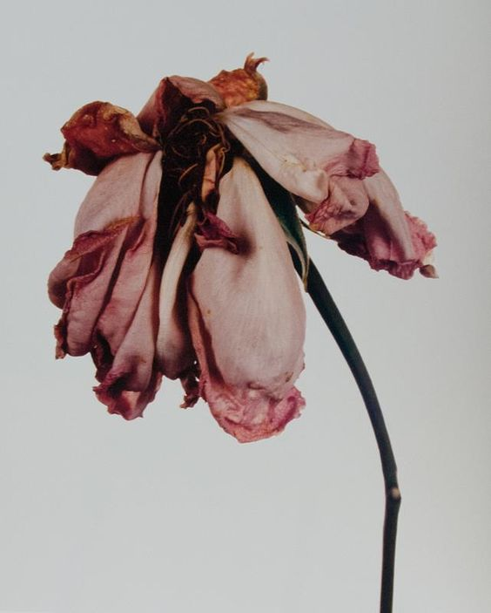
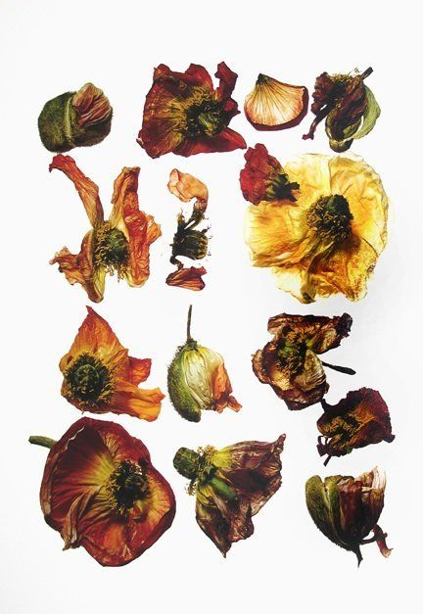
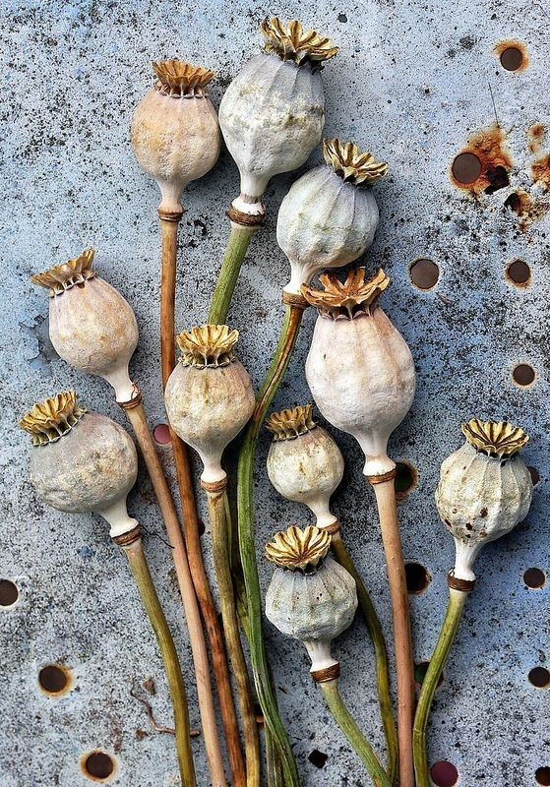
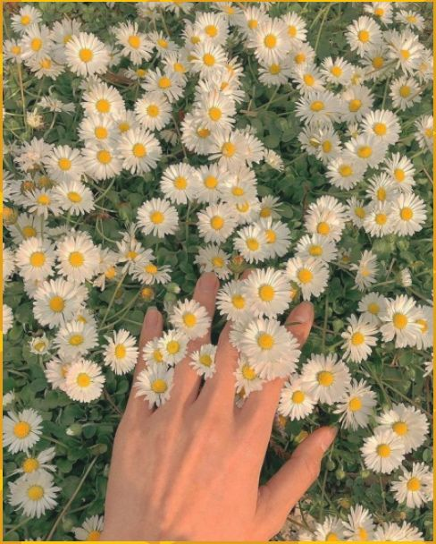
Consider the impact of:
* Unusual pairings (for example the organic poppy seed heads set against a background of rusty metal)
Combining natural forms with the human form
A bright white background to give a crisp, professional effect.

Slide 6
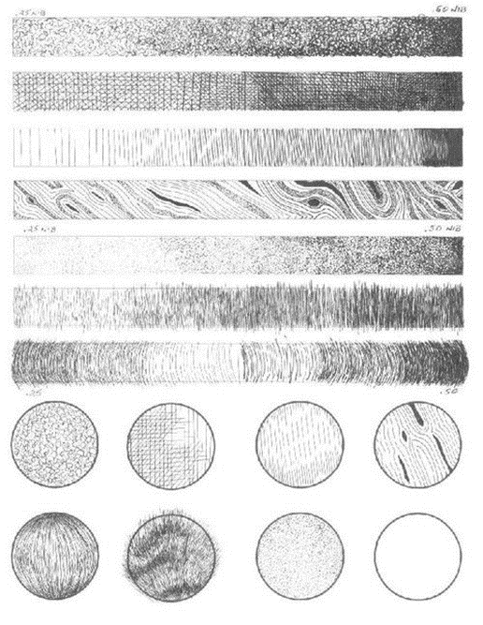
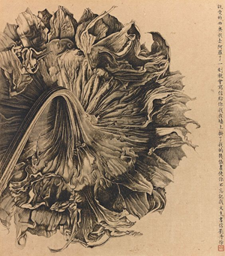
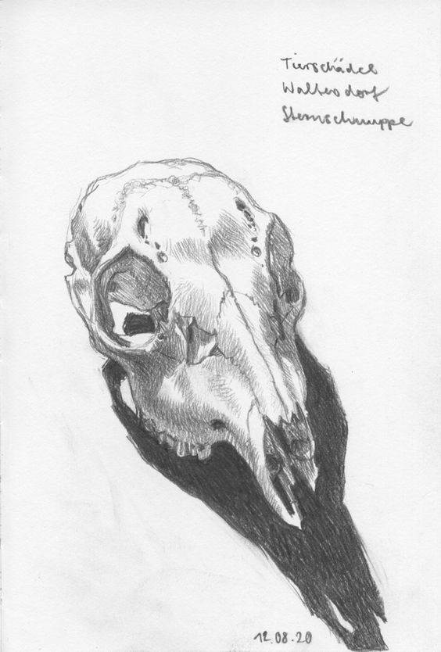
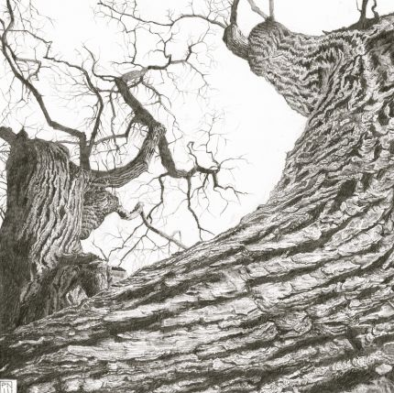
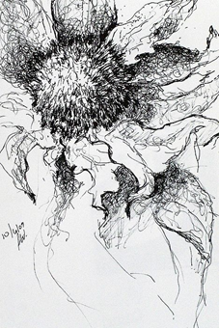
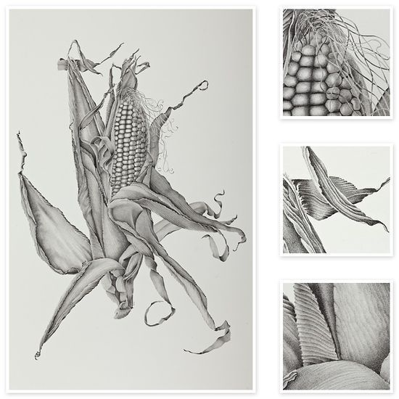
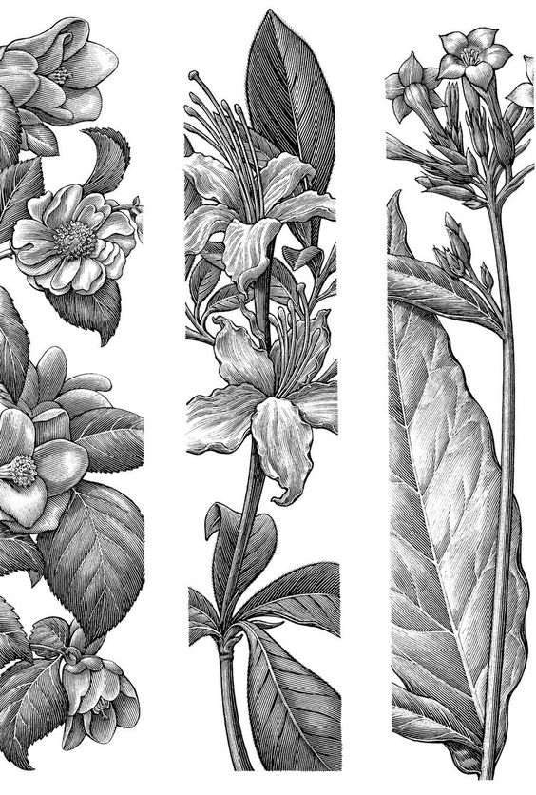
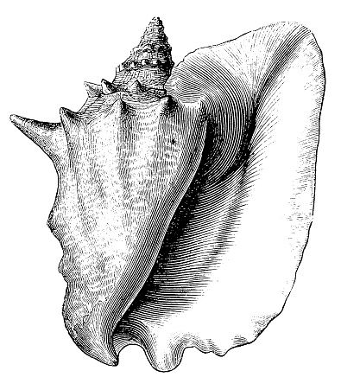
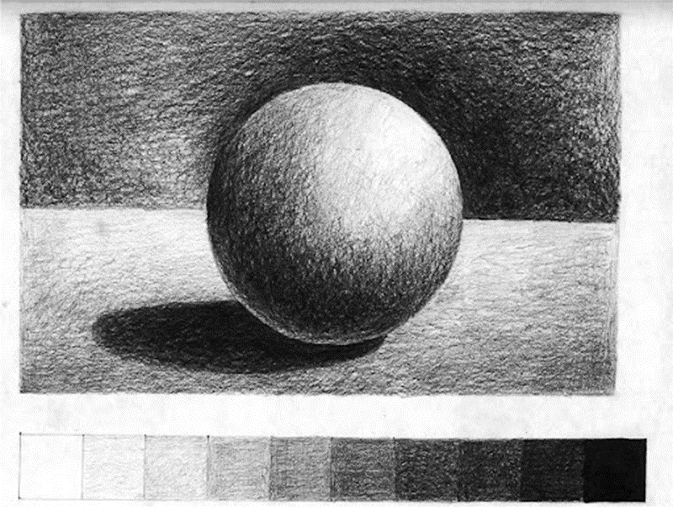
Key words: Tonal variation, direction of line, depth, form, space organic, highlight, mark-making, composition, positive and negative space.
Addressing common mistakes when applying tone:
Build tone through mark-making; hatching, cross hatching, stippling etc rather than smudging. This indicates texture rather than a strange smoothness.
Focus on the simple effect of varying the pressure of your pencil to create different tones within simple pencil lines. Avoid heavy outlines.
Really focus on using direction of lines in your shading to give a sense of form.
Squint your eyes and look for comparative tones.

