Slide 1
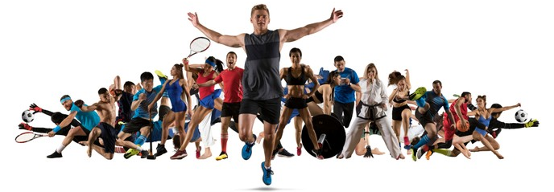
Level 2 CNAT Sport Science PE Kickstart
Summer 2024

Slide 2
TASK 1: Components of Fitness Research Complete the below research tasks
Component of Fitness | Definition
Cardiovascular Endurance
Muscular Endurance
Speed
Strength
Power
Agility
Balance
Flexibility
Coordination
Reaction Time
Using the link to BBC Bitesize:
Components of Fitness
Watch the video on the explanation of different components of fitness
Research and give a definition for each of the components of fitness in the table

Slide 3
Task 2: Application to a sport Complete the table
Research and give specific sporting examples where each component of fitness is used.
Do not just state a sport, be specific with where it is used in the sport.
Agility = Rugby
Agility = This is used in Rugby when…
Component of Fitness | Sporting Example
Cardiovascular Endurance
Muscular Endurance
Speed
Strength
Power
Agility
Balance
Flexibility
Coordination
Reaction Time

Slide 4
Task 3: Fitness Testing Research fitness testing and complete the table below
Component of Fitness | Name of Fitness Test | Diagram of Test
Cardiovascular Endurance
Muscular Endurance
Speed
Strength
Power
Agility
Balance
Flexibility
Coordination
Reaction Time
PART 3A
Research the protocols for each test and write notes on each one.

