Slide 1
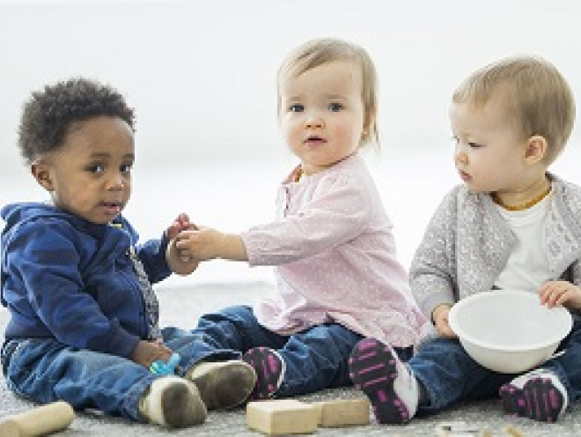
Child Care
Kick start to GCSE

Slide 2
What do I need to do?
Complete the following tasks on paper or using your iPad. Be creative with this work and take pride in it – it’s the first work you will complete for your GCSE in Childcare!
Bring your work to your first Childcare lesson.
This course is made up of 3 exam elements. You will have 2 NEA’s (task-based scenarios) and 1 exam at the end of year 11.
We will complete your first NEA in year 10.

Slide 3
Task 1
Children develop in different areas:
Physical
Intellectual or Cognitive
Language
Emotional
Social
We call this our P.I.L.E.S
Tell what a child should be doing at these ages and stages:
Physical – 6 months
Intellectual or Cognitive – 1 year
Language – 2 years
Emotional – 3 years
Social – 5 years
Development Area | Age | What can the child do?
Physical | 6 months
Intellectual / Cognitive | 1 year
Language | 2 years
Emotional | 3 years
Social | 5 years

Slide 4
Task 2
There has been a long argument over whether Breast or Formula Milk is better for babies. I would like for you to tell me about this argument. What are the reasons for and against using either.
Give your opinion on what you think is best and why?

Slide 5
Task 3
When we work with children we like to inspire them to use their imagination.
I want to see what your imagination is like . . .
Imagine yourself as a superhero.
Write a description of your superhero or draw me a picture!
Tell me what special powers do you have?
Where would you live?
What would you do all day and all night?

Slide 6
Task 4
A nursery wants to redesign their baby room. They have asked you to research some equipment they could buy. You need to provide the nursery manager with 3 examples of each of the following equipment:
Feeding Equipment
Sleeping Equipment
Changing Equipment
You need to give the following details to the nursery manager:
Cost
Dimensions
What age child is it suitable for
Whether you recommend the product and why

