Slide 1
Little Dorrit by Charles Dickens
Thirty years ago, Marseilles lay burning in the sun, one day.
A blazing sun upon a fierce August day was no greater rarity in southern France then, than at any other time, before or since. Every thing in Marseilles, and about Marseilles, had stared at the fervid sky, and been stared at in return, until a staring habit had become universal there. Strangers were stared out of countenance by staring white houses, staring white walls, staring white streets, staring tracts of arid road, staring hills from which verdure was burnt away. The only things to be seen not fixedly staring and glaring were the vines drooping under their loads of grapes. These did occasionally wink a little, as the hot air barely moved their faint leaves.”
GCSE English Language
Paper 1
List 4 things that were staring.
-
-
-
-
NEW VOCABULARY: Define and create a sentence for the following words
1. Rarity
2. Fervid
3. Universal
4. Countenance
5. Arid

Slide 2
Knowledge – Identify
What was the weather like in Marseille? Find three short quotes to support your ideas.
Understand – Explain
Why do you think the vines were the only thing not “staring” at the sky”? Find two quotes to support your ideas.
Apply - Choose
How does the writer use language to describe the weather in Marseilles? One What/How/Why paragraph
Analyse – Compare & Contrast
Compare how the writer describes the vines to the town. One Comparative What/How/Why paragraph
Synthesise – Summarise
Summarise what the weather is like at this point in the extract. Find three quotes to support your ideas.
Evaluate – Select & Justify
“The writer creates an uncomfortable atmosphere in the extract.” To what extent do you agree? Two What/How/Why paragraphs, include why you agree or disagree with the statement.
CHALLENGE: How does the writer structure the text to create a sense of foreboding with the weather? Two What/How/Why paragraphs

Slide 3
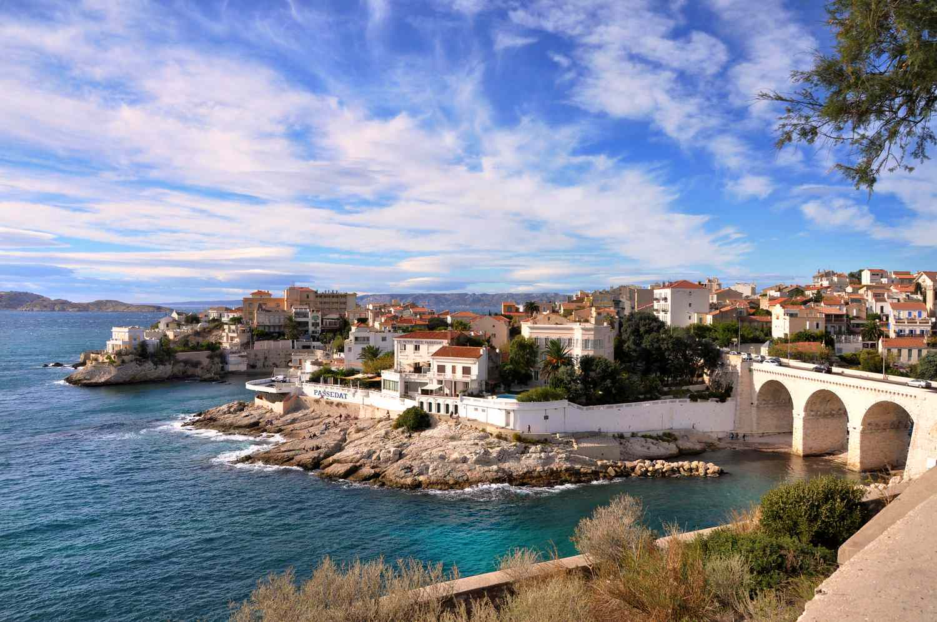
Choose one of the tasks below:
Write a description inspired by the image opposite.
Write an opening to a short story with extremely hot weather.
Structure
Language
Vocabulary
Cyclical
Semi-colon
Varied sentence starts
Oxymoron
Personification
5 senses
Fervid
Arid
Rarity

Slide 4
GCSE English Literature: Set Texts (recommended versions)
Autumn 2
Spring 2
Summer 2
The Strange Case of Dr Jekyll & Mr. Hyde
£7.99 - £5.19*
Romeo and Juliet: Accessible Shakespeare
£5.99 - £4.17*
An Inspector Calls: Annotation-Friendly Edition
£9.99
*Discount available via school purchase, contact cmarkham@dma.tela.org.uk

