Slide 1
Getting ready for…
GEOGRAPHY
AQA GCSE
Complete the following tasks to get yourself ready for the GCSE Geography course.

Slide 2
1. I can label the 8 point compass Name the directions of the 8 point compass.

Slide 3
2 I can work out the direction from one point to another point on a map Can you remember the rule for finding a grid reference? Along the… ______________________________________________________________________________________________________________
Follow the trail on the map below
In the table on the next page
Identify what each OS map symbol represents
b. Give the four figure grid reference for each symbol.

Slide 4
Symbol | Represents | Grid Reference
Imagine you have to tell a year 5 how to use 6 figure grid references. Using the grid in the space below to explain how you would find a six figure grid reference.

Slide 5
3. I can work out the direction from one point to another point on a map Look at the Ordnance Survey map below:
If you were to do each journey below which direction would you need to travel in? ◊ Carr Bottom to Weir Mills: ­­­­__________
◊ Brough to Bamford: __________
◊ Shatton Moor to Offerton Moor: __________
B3. I know what the scale on a map is for and how to use it
What is the scale on a map used for? How would you use the scale on a map?

Slide 6
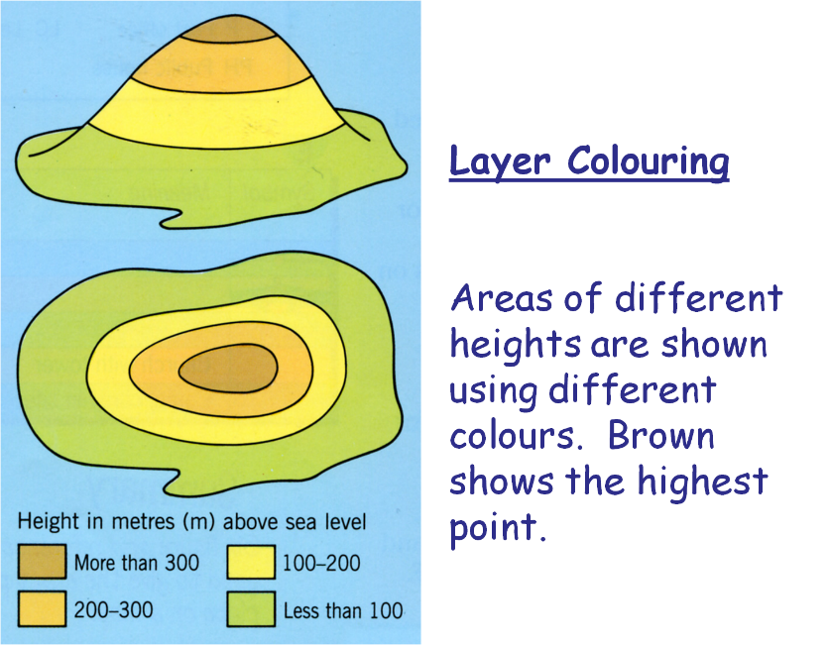
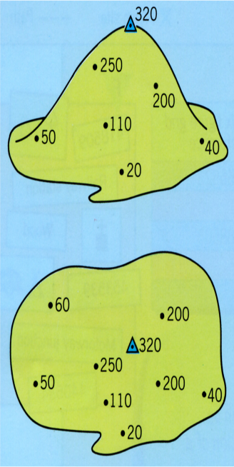
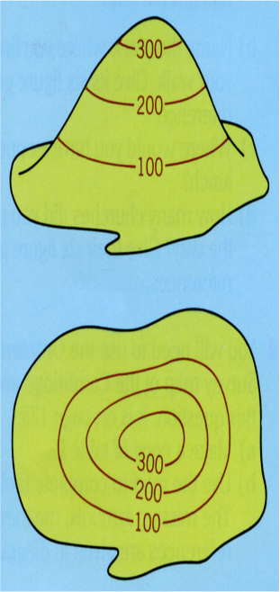
Using the scale 2cm = 1 km to try to give the distance between the following places on the OS map
◊ Elmore Farm to Hope Station: __________
◊ Old Lees Farm to Rebellion Knoll: __________
◊ High Field Head Farm to Weir Mills: __________
4. . I can give the 4 figure grid reference of point on a map
Study the OS map and give the four figure grid references for:
◊ Thornhill telephone: ______________ ◊ Hope Station: __________
◊ Bamford Public House: __________ ◊ Bamford Station: __________
◊ Offerton Hall: __________ ◊ Bamford Campsite: __________
5. I can find a point on a map using a 4 figure grid references
Using the OS map to identify what the point of interest is at each grid reference
◊ What is the name of the town in grid reference 1983? ________________________________
◊ Where can people stay in grid reference 1883? ______________________________________
◊ What is the name of the river flowing through grid reference 1982? ___________________
Height on a Map
There are three ways of showing height on a map.
Colour Shading Spot Heights Contour Lines
Colour Shading are bands of different colours that show areas of the same height
Spot Heights are numbers that show the exact height of a place
Contours are lines on a map that join up points of the same height

Slide 7
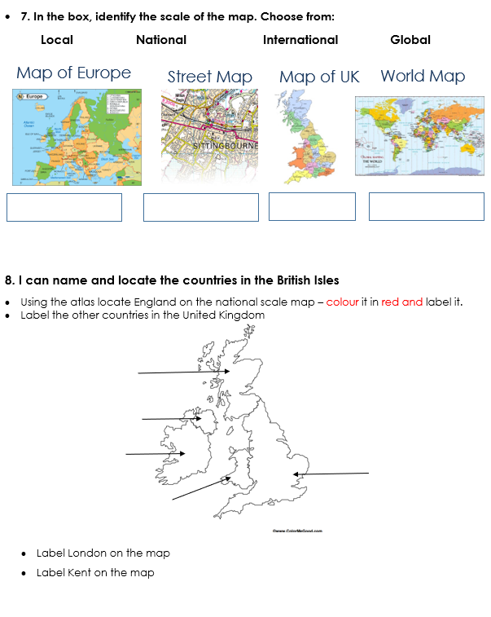

Slide 8
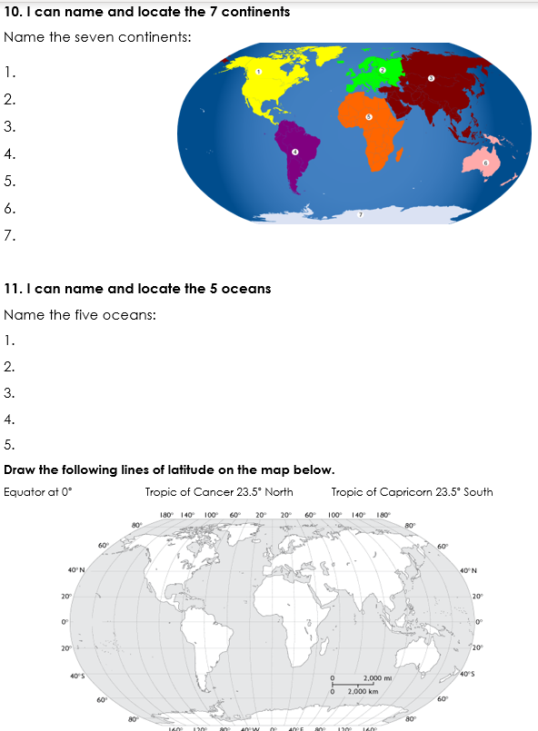

Slide 9
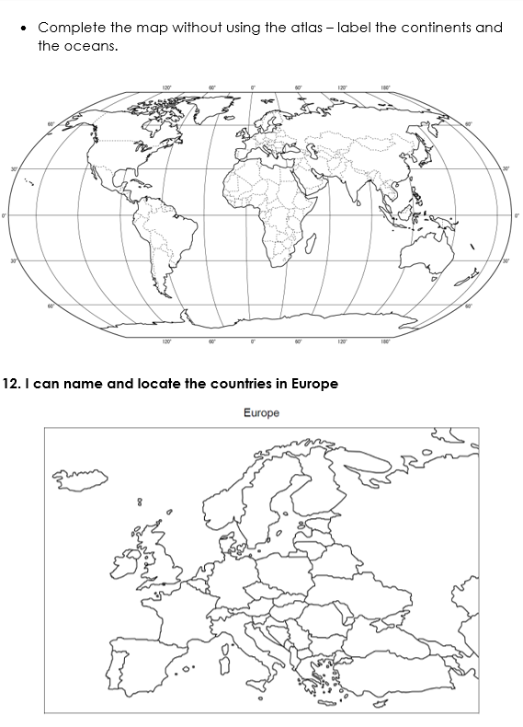

Slide 10
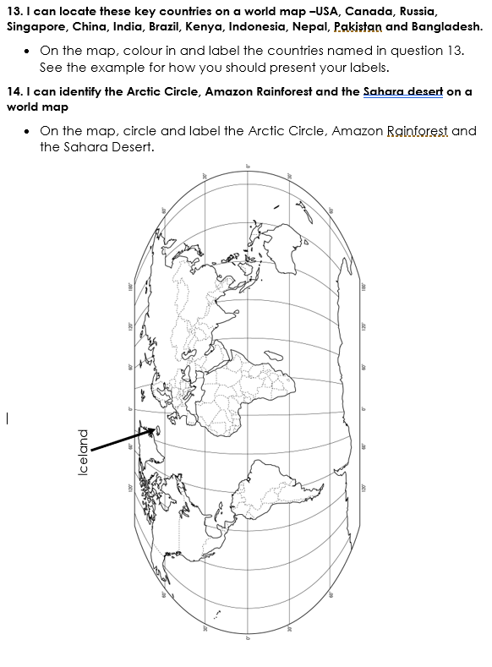

Slide 11
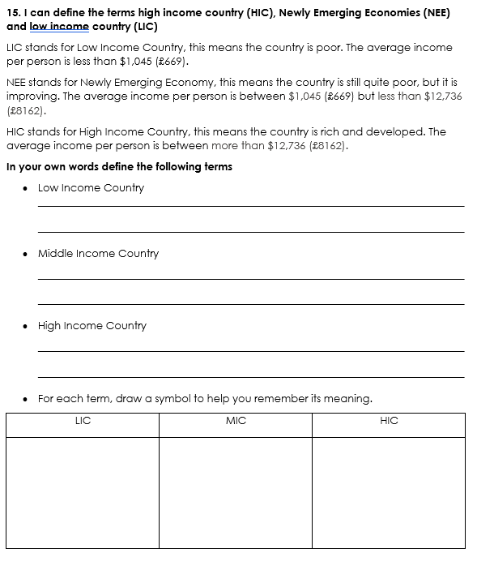

Slide 12
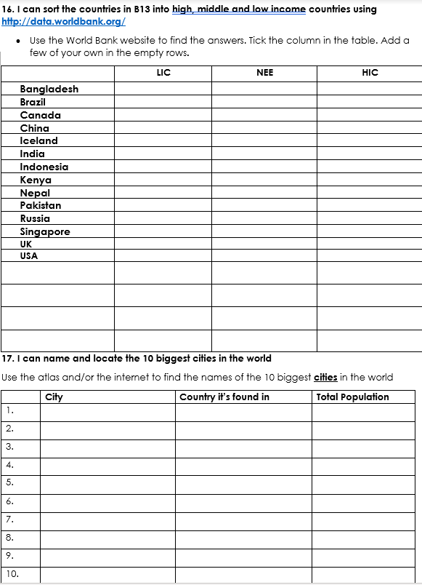

Slide 13
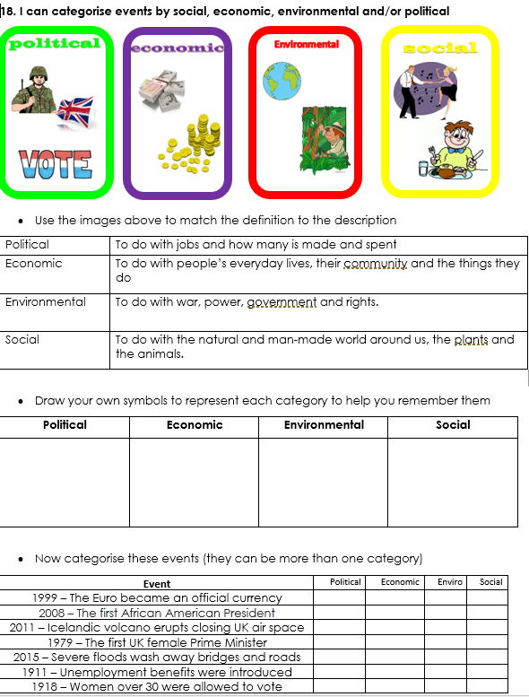

Slide 14
