Slide 1
Hard Technology Summer Preparation Task.
Designing is largely problem solving. The field of design may change but ultimately there is a thing that needs to be invented/ adapted/ manufactured to make something better and it is the job of a designer to do that.
“Engineers make things that work, and they make things that work better.” Professor Bill Lucas.
But designers have to be smart. There is no point in exactly recreating a thing that already exists, so a good designer will analyse existing products before starting to create their solution.
In order to excel in product design this is a skill you will need to develop – so we’re starting you off now…
Over the summer we would like you to produce a detailed product study about a product of your choice.
You need to choose a product which you think could be improved. Your job is to analyse the original product that you have at home.
(Before you start taking things apart please check with an adult that it is safe and you are allowed!)
The next slides show some examples and a checklist of the things your product study should include.

Slide 2
Produce a detailed product study that includes…
A photograph of the product you have chosen.
A list of parts, including the materials that have been used.
For each part/ material state at least 2 properties of the material and explain why these properties make it suitable.
Use ACCESSFM to analyse the current product and make judgements about the good and bad points.
Make suggestions about how the product could be improved, include annotated drawings to show these improvements.
An investigation in to how a main part or parts of the product have been manufactured. Provide written details of this, including diagrams where possible.
An exploded diagram of the product.
An orthographic drawing of the product, including dimensions.

Slide 3
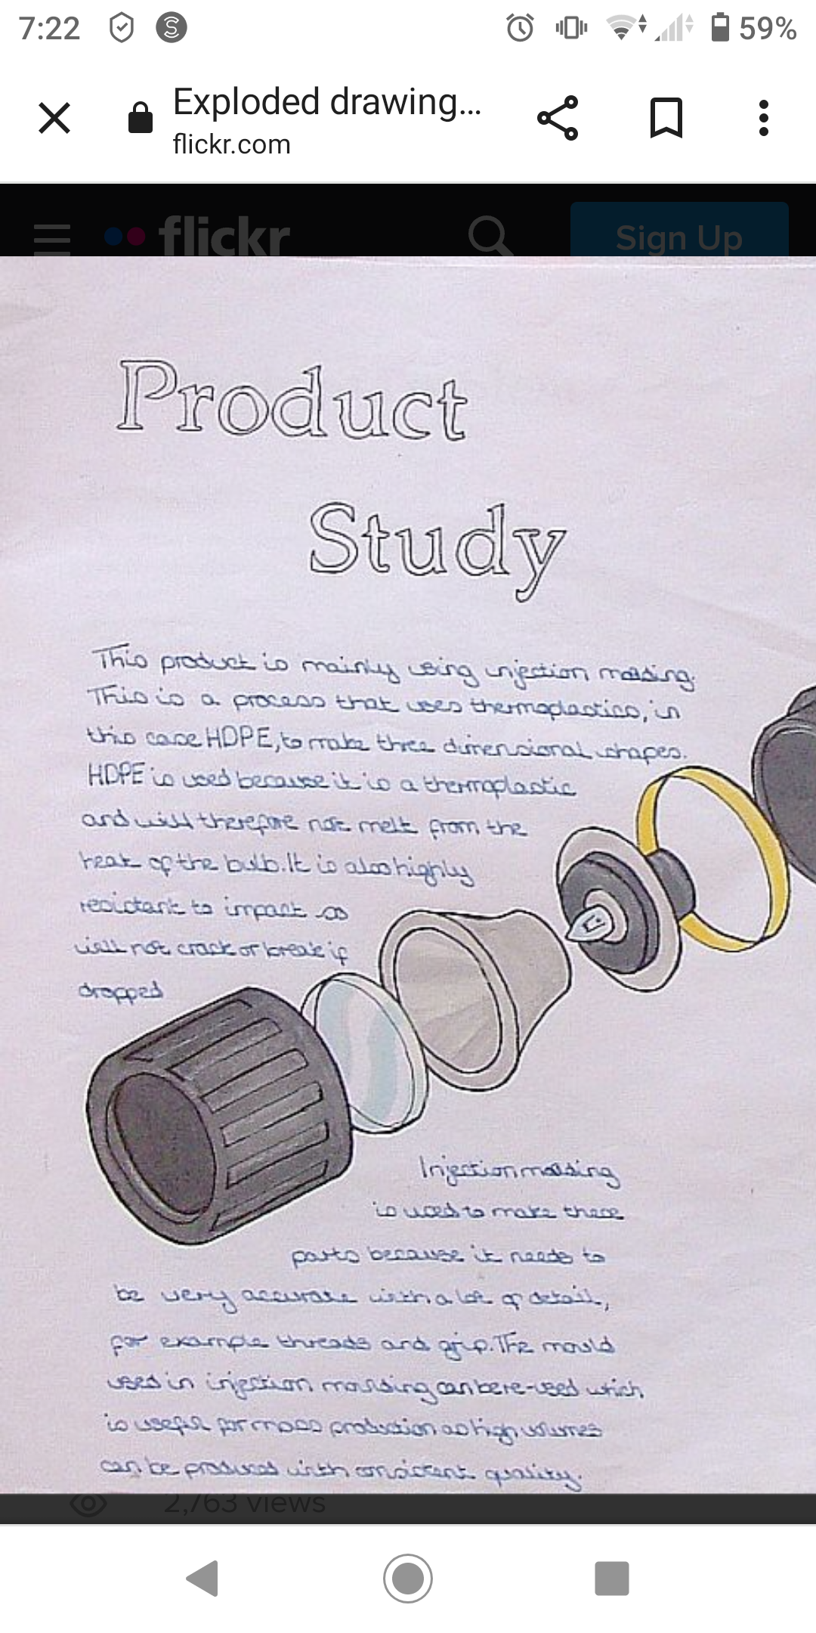
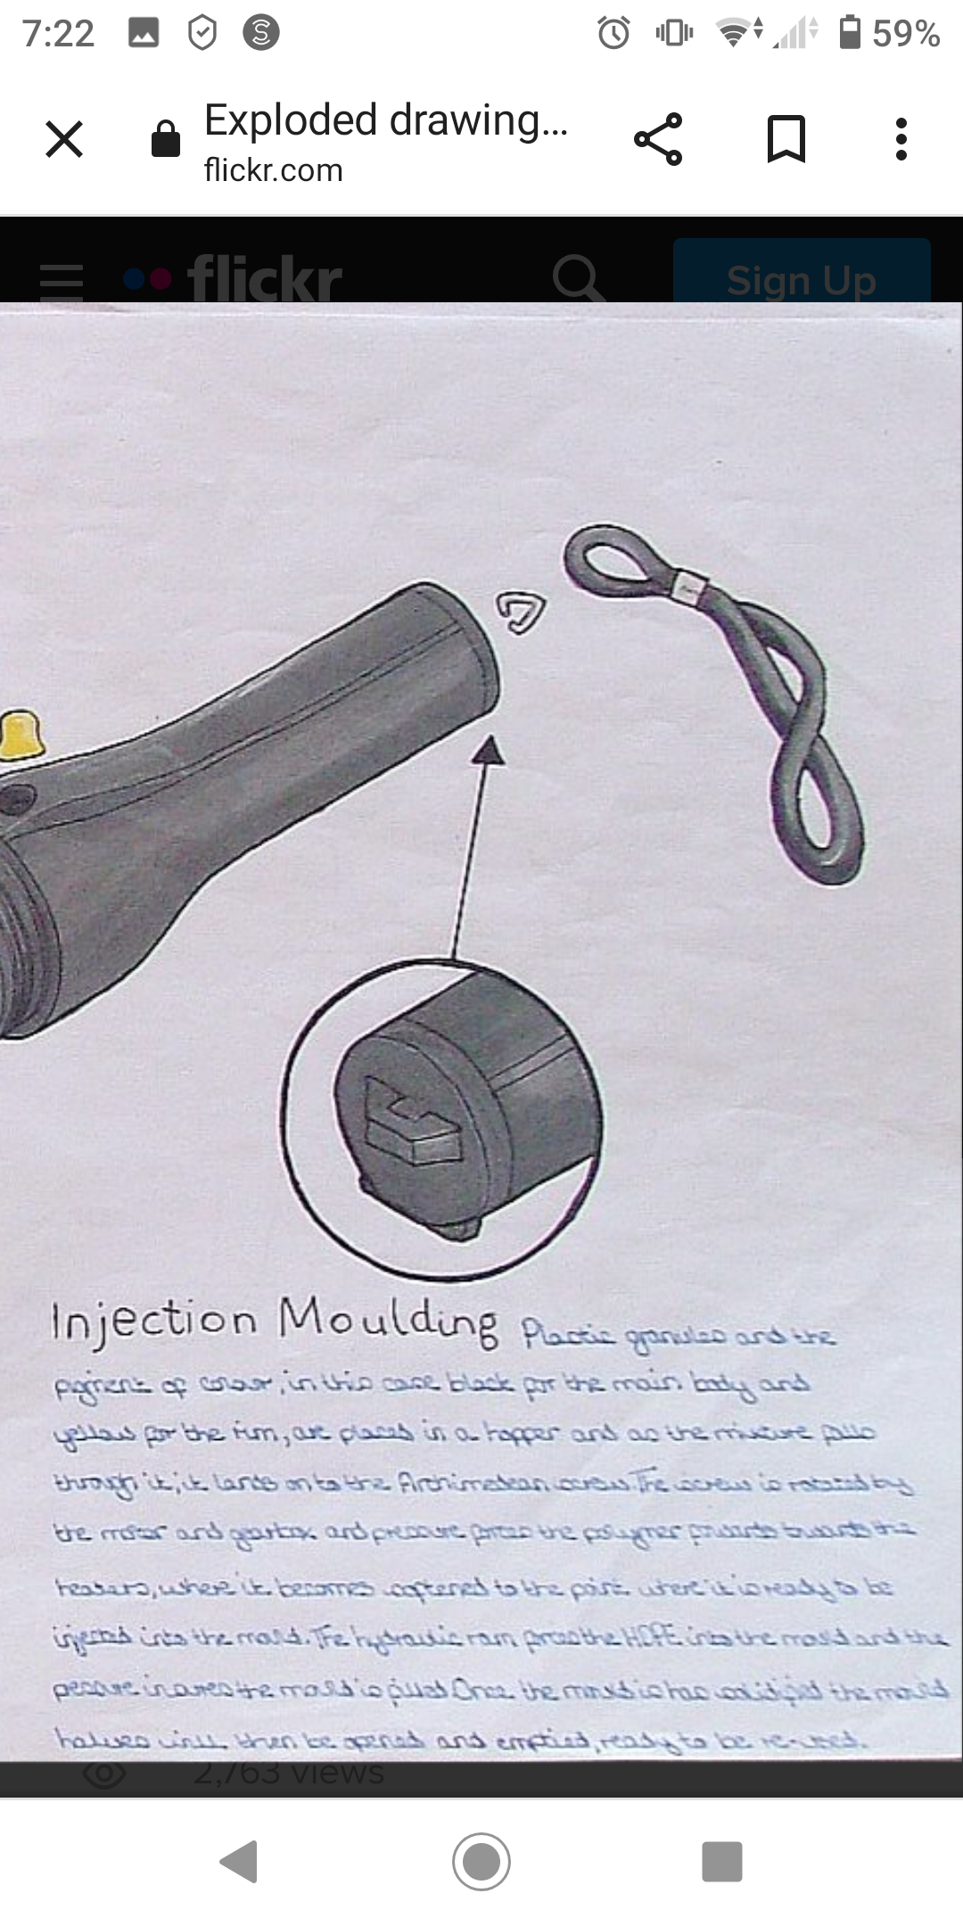
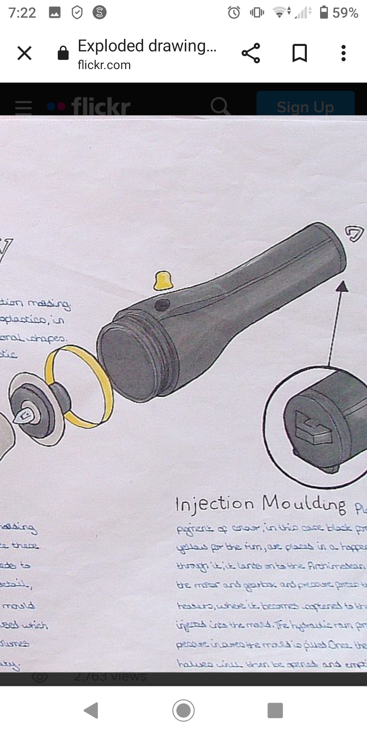
Example: An exploded diagram.

Slide 4
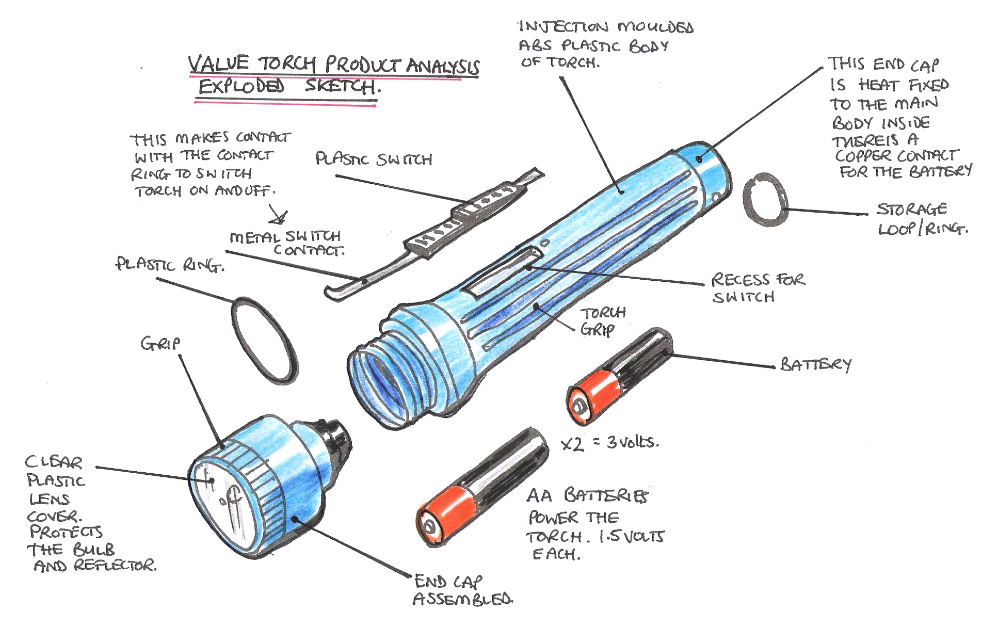
Example: An exploded diagram.

Slide 5
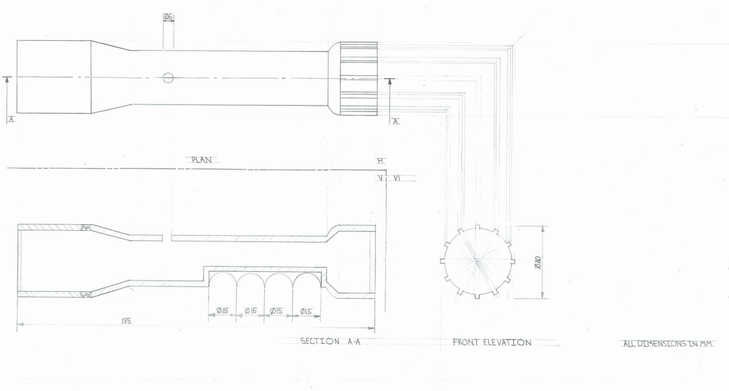
Example: Orthographic drawings. Remember to use a pencil, ruler and include dimensions.

Slide 6
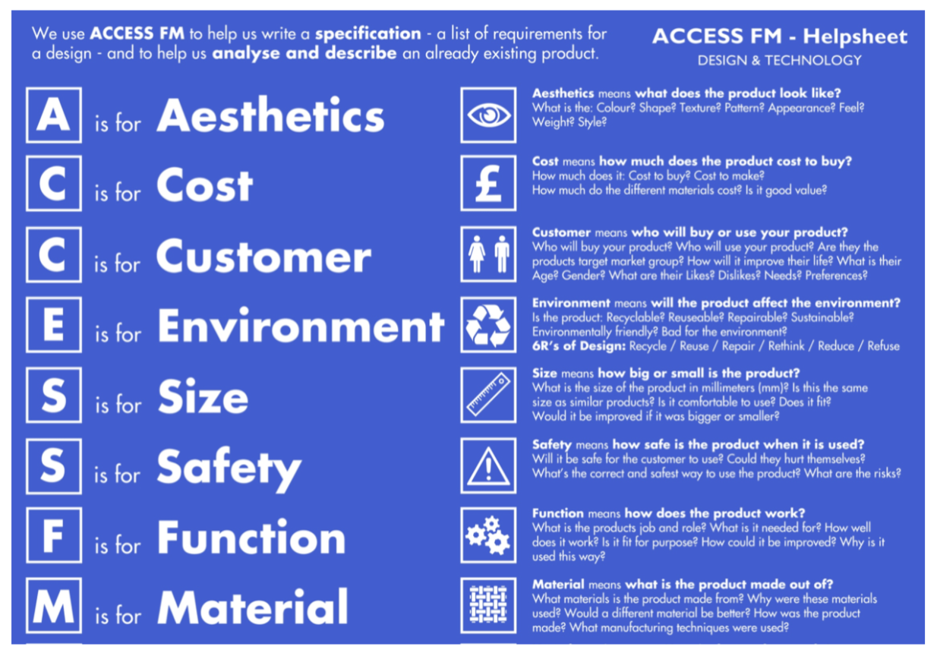
Help sheet:

Slide 7
Help sheet:

Slide 8
Help sheet:

Slide 9
Help sheet:

