Slide 1
MEDIA
STUDIES

Slide 2
SUMMER PREP TASKS
Slides
Tasks
Help
The following slides contain your Summer Prep Tasks for Media Studies.
Please complete all tasks outlined, to the best of your ability, by our first class together in September.
Full instructions are available on this ppt, including examples and links to additional help. If you are really stuck, email me: cmarkham@dma.tela.org.uk

Slide 3
Magazines: We need to learn the media terminology for what is on the front cover of magazines. These are conventions.

Slide 4
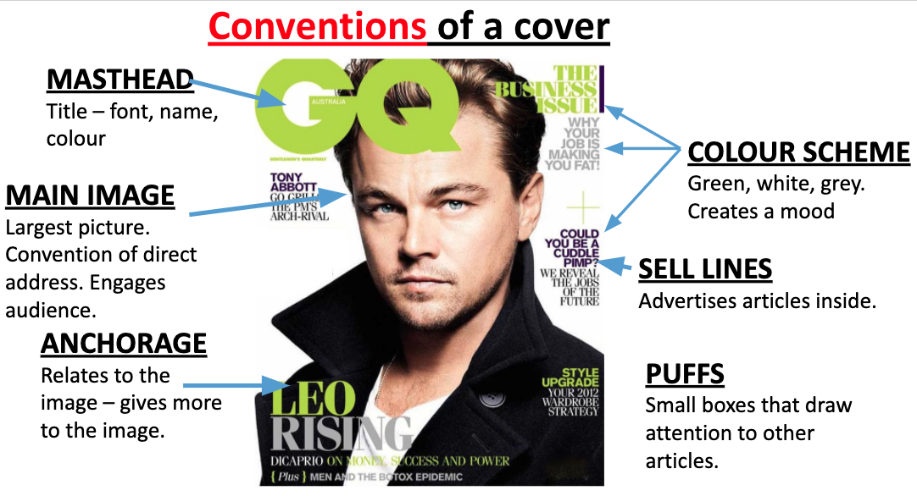
Conventions of a cover
A
C

Slide 5
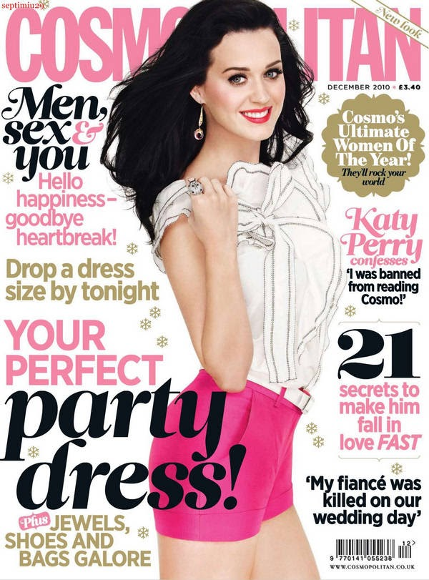
Now label this magazine with the same conventions:

Slide 6
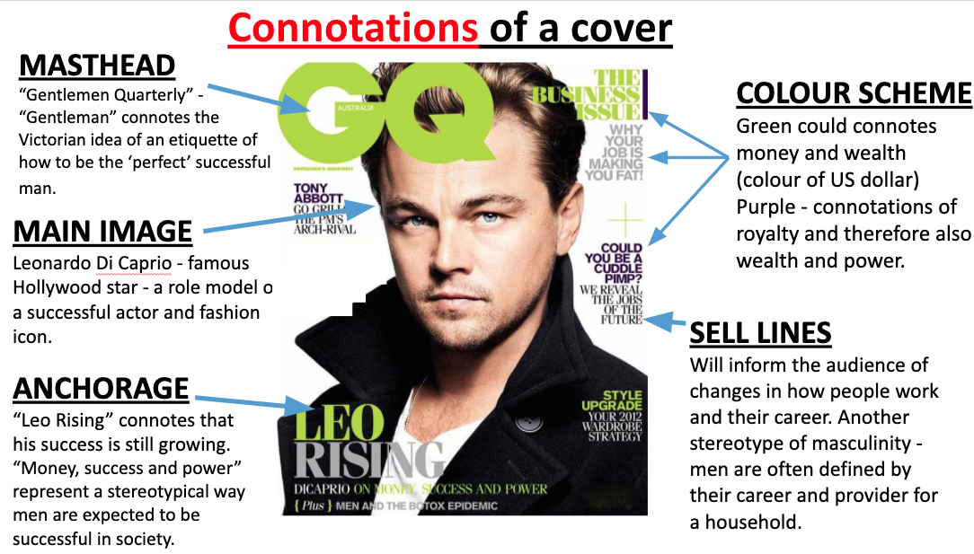
You need to analyse the conventions for the meaning that they are communicating.

Slide 7
Now analyse the conventions on the front cover of Cosmopolitan. Label 4 other conventions - what are they communicating about Katy Perry, the magazine, the stories that will be in the magazines or what they audience will learn from the magazine?

